Slide 1
Neural Network for cost estimation: Hyperparameter tuning

Slide 2
Overview
Problem setting + motivation (2-3)
Methodology
Process overview (1)
Optimization problem (2)
Neural network (2)
Line benefits (1)
Clustering process (1)
Results thus far
Neural network output (6)
Line benefits (2)
Future tasks (1)

Slide 3
Process overview
Benchmark:
Full time horizon
Input Data
ESOM
Traditional:
Split time horizon
Input Time Series
Clustering
Method
Representative Time Series
ESOM
Relaxed ESOM
Features
Clustering
Method
Representative Time Series
ESOM
Based in Costs:
Split time horizon
(ANN + Kmedoids)
Clustering
Method
Investment Benefit
Proposal:
Split time horizon
ANN: Cost Estimator
Features
(Investment benefit)
Representative Time Series
ESOM
*ESOM: Energy System Optimization Model
**ANN: Artificial Neural Network

Slide 4
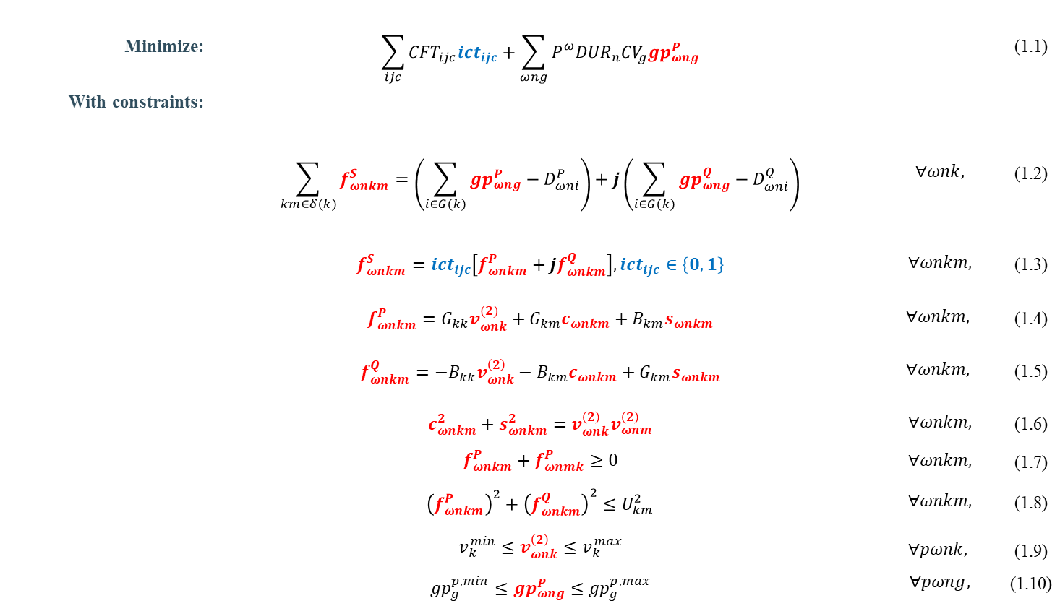
ESOM: Transmission Expansion Planning considering AC-OPF
Minimize: | $$\sum_{ijc}{{CFT}_{ijc}{ict}_{ijc}}+\sum_{ωng}{P_{}^{ω}{DUR}_{n}{CV}_{g}{gp}_{ωng}^{P}}$$ |  | (1.1)
With constraints:
 | $$\sum_{km∈δ(k)}{f_{ωnkm}^{S}}=\left(\sum_{i∈G(k)}{{gp}_{ωng}^{P}−D_{ωni}^{P}}\right)+j\left(\sum_{i∈G(k)}{{gp}_{ωng}^{Q}−D_{ωni}^{Q}}\right)$$ | $$∀ωnk,$$ | (1.2)
 | $$f_{ωnkm}^{S}={ict}_{ijc}\left[f_{ωnkm}^{P}+jf_{ωnkm}^{Q}\right],{ict}_{ijc}∈\left\{0,1\right\}$$ | $$∀ωnkm,$$ | (1.3)
 | $$f_{ωnkm}^{P}=G_{kk}v_{ωnk}^{(2)}+G_{km}c_{ωnkm}+B_{km}s_{ωnkm}$$ | $$∀ωnkm,$$ | (1.4)
 | $$f_{ωnkm}^{Q}=−B_{kk}v_{ωnk}^{\left(2\right)}−B_{km}c_{ωnkm}+G_{km}s_{ωnkm}$$ | $$∀ωnkm,$$ | (1.5)
 | $$c_{ωnkm}^{2}+s_{ωnkm}^{2}=v_{ωnk}^{\left(2\right)}v_{ωnm}^{\left(2\right)}$$ | $$∀ωnkm,$$ | (1.6)
 | $$f_{ωnkm}^{P}+f_{ωnmk}^{P}≥0$$ | $$∀ωnkm,$$ | (1.7)
 | $${\left(f_{ωnkm}^{P}\right)}^{2}+{\left(f_{ωnkm}^{Q}\right)}^{2}≤U_{km}^{2}$$ | $$∀ωnkm,$$ | (1.8)
 | $$v_{k}^{min}≤v_{ωnk}^{\left(2\right)}≤v_{k}^{max}$$ $${gp}_{g}^{p,min}≤{gp}_{ωng}^{P}≤{gp}_{g}^{p,max}$$ | $$∀pωnk,$$ $$∀pωng,$$ | (1.9) (1.10)
Non-convex
Getting a MILP model by applying:
Disjunctive constraints
Piecewise functions
McCormick envelopes

Slide 5
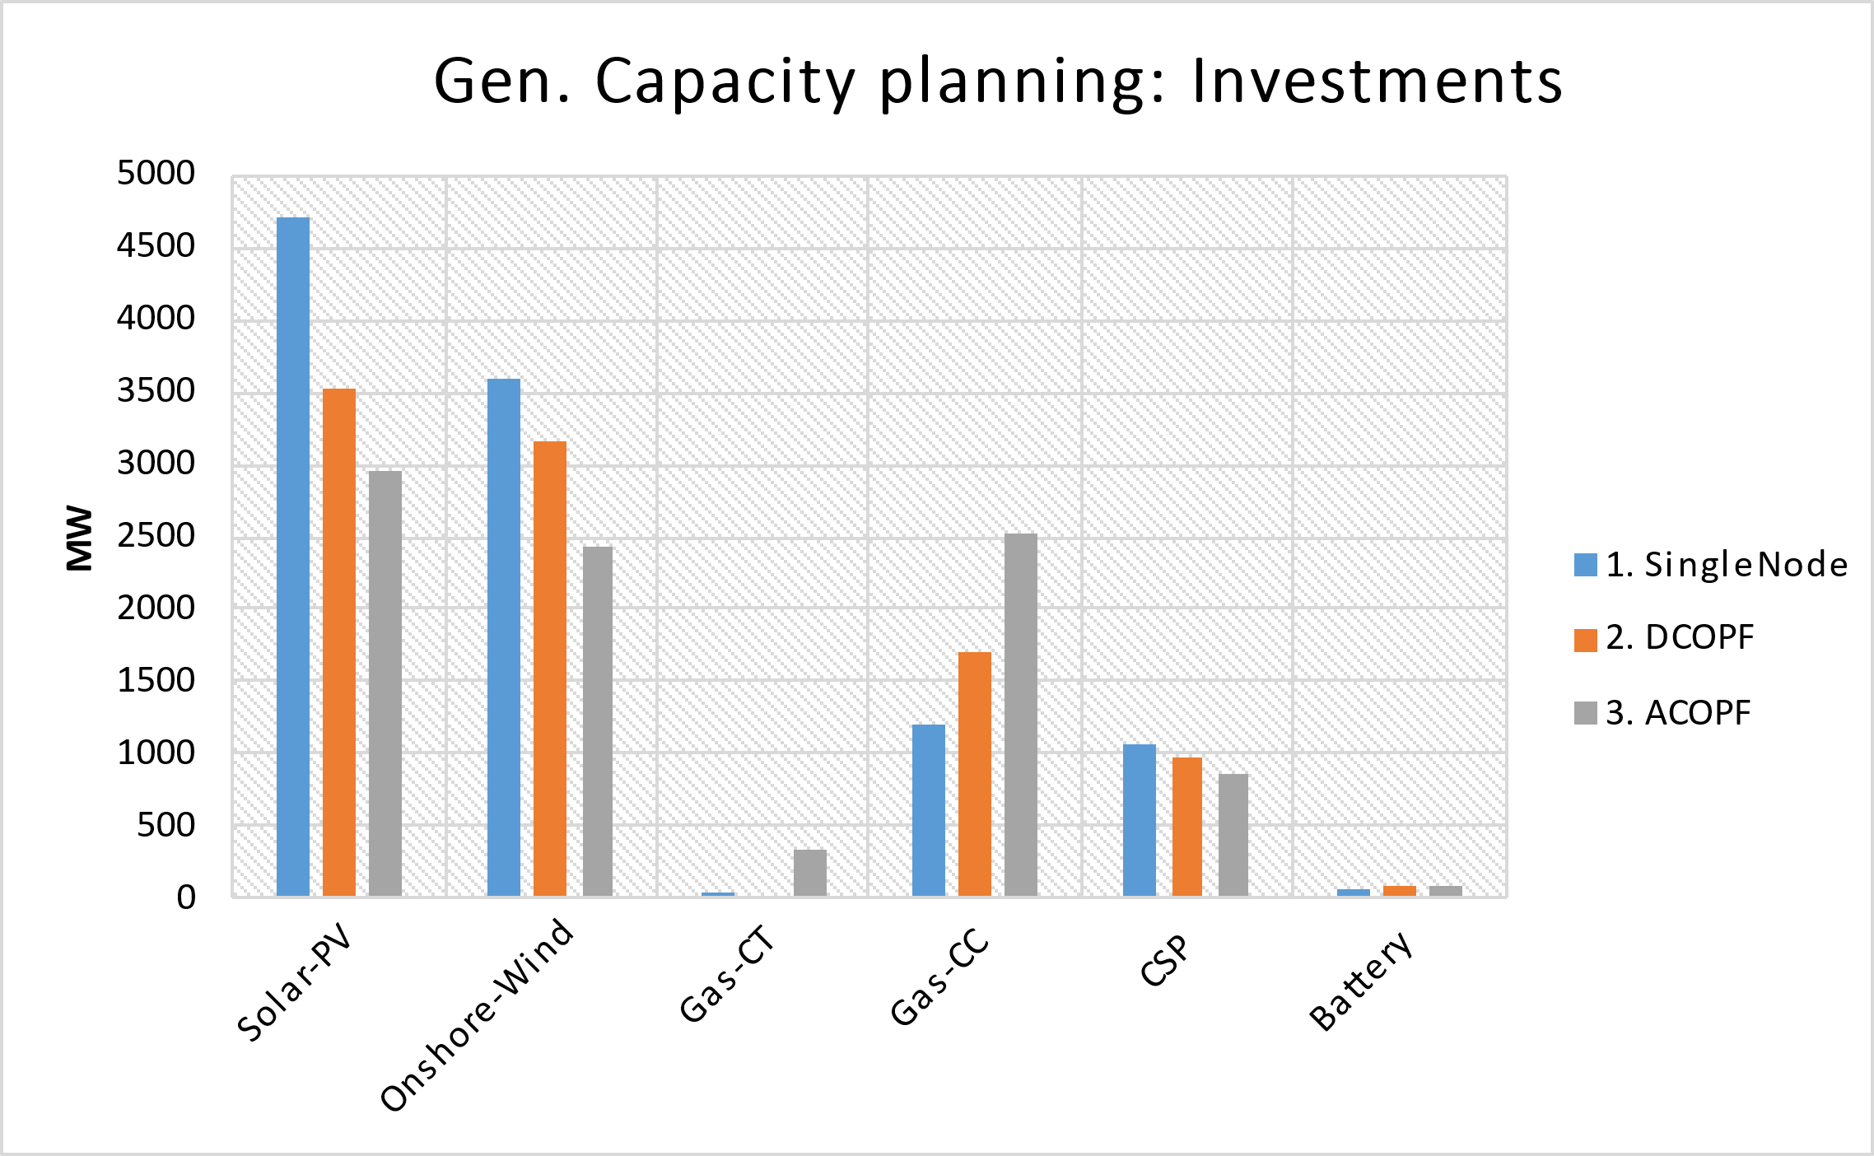
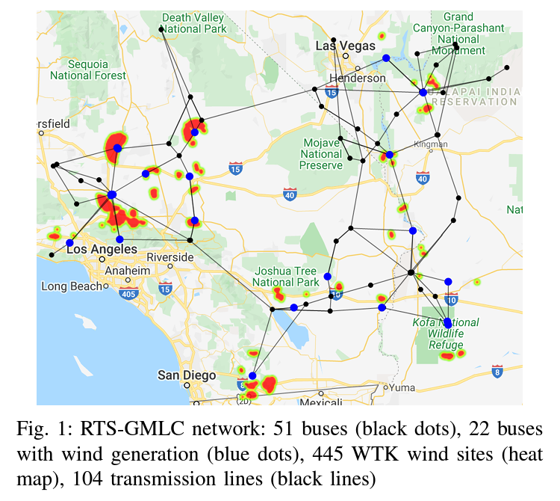
ESOM: Why considering AC-OPF?
Disadvantages:
ACOPF’s problem size is ~4x-6x of the DCOPF
Computation burden: ~6x-10x
Implications on the Gen. capacity planning
Implications on the transmission expansion
RTS-GMLC
Source: Scenario Creation and Power Conditioning Strategies for
Operating Power Grids with Two-Stage Stochastic Economic Dispatch
Link: https://www.nrel.gov/docs/fy21osti/75363.pdf

Slide 6
Neural Network for cost estimation
Goal
Estimate the hourly operational cost of the OPF problem
Sensitive to
time-series changes
physical network changes
Approach
Neural network works on hourly basis → Estimates one cost value
Single output (cost)
Input contains
Demand (per node)
Renewable availability factors (per technology per location)
Admittance matrix
Size of input vector quickly grows with number of buses
Demands
Availabilities
Admittance matrix
Input layer
…
…
…
Hidden layer
…
Single output
Operational cost for one hour

Slide 7
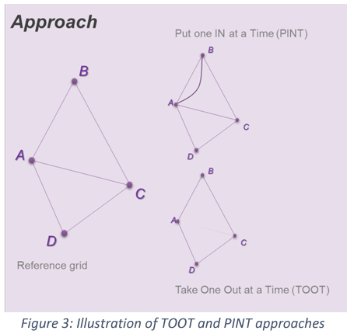
Line Benefits
The PINT and TOOT
Investment Benefit
ANN: Cost Estimator
Sequence per candidate asset and hour
PINT (or TOOT)
Reference grid
ANN Cost
Estimator
ANN Cost
Estimator
Line Benefit Methods:
The Put IN one at the Time (PINT)
The Take Out One at the Time (TOOT)
Shapley value
Aumann-shapley value
Benefit 1 (Benefit 2) =
Reference grid – PINT
(TOOT – Reference grid)
[source] ENTSO-E: Guideline for Cost Benefit Analysis of Grid Development Projects
Link: https://eepublicdownloads.entsoe.eu/clean-documents/tyndp-documents/Cost%20Benefit%20Analysis/191023_CBA3_Draft%20for%20consultation.pdf

Slide 8
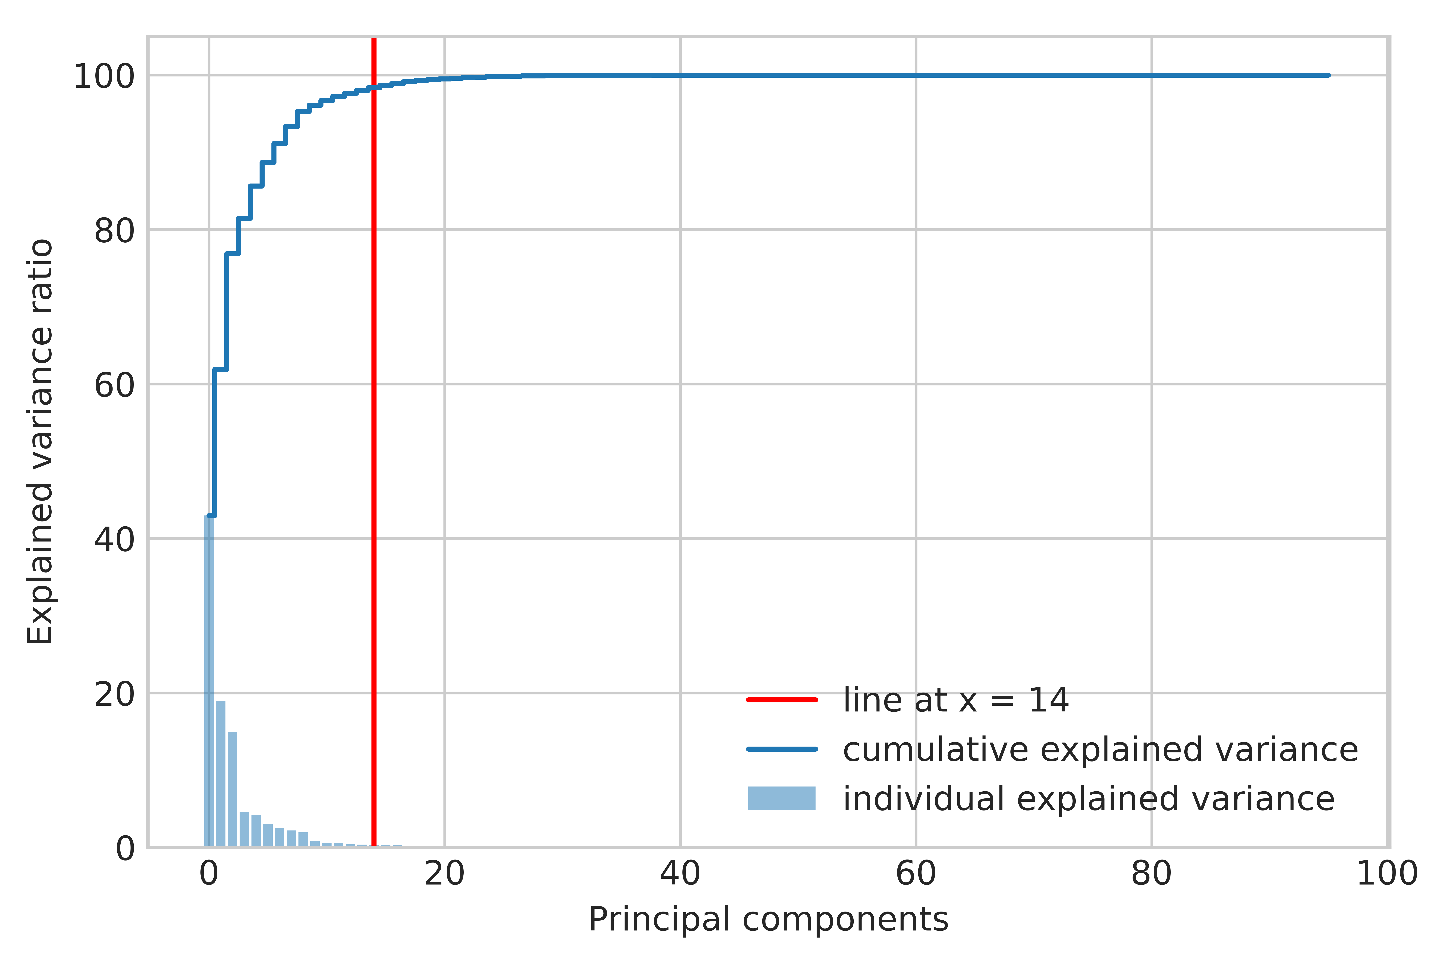
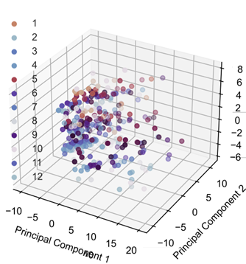
Clustering process
Dimensionality reduction
Optimal number of representatives/clusters
Selection/aggregation using K-medoids
Dimensionality reduction using PCA
Optimal number of clusters

Slide 9
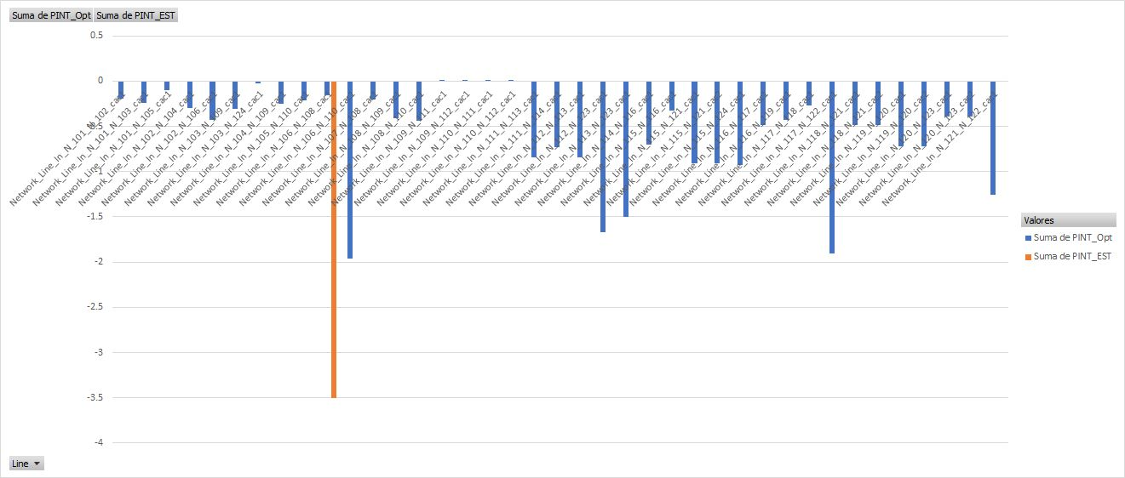
Line Benefits: Preliminary results

Slide 10
